Slide 1
GENO8232 Lab 3
Slides adapted from https://github.com/stat115/Lab_2020
RNA-seq, Batch effects, differential gene expression analyses

Slide 2
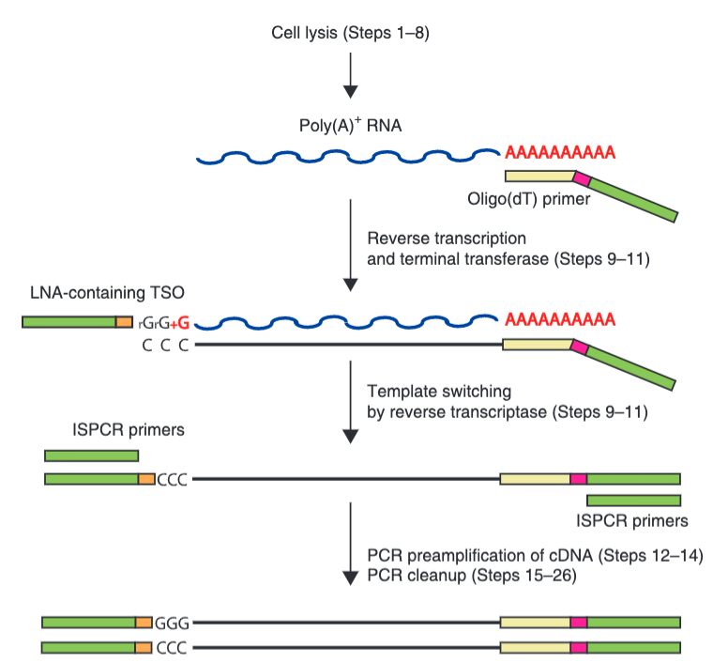
Reminder: RNA-seq isn’t typically sequencing RNA
Picelli et al. Nature Protocols 2013

Slide 3
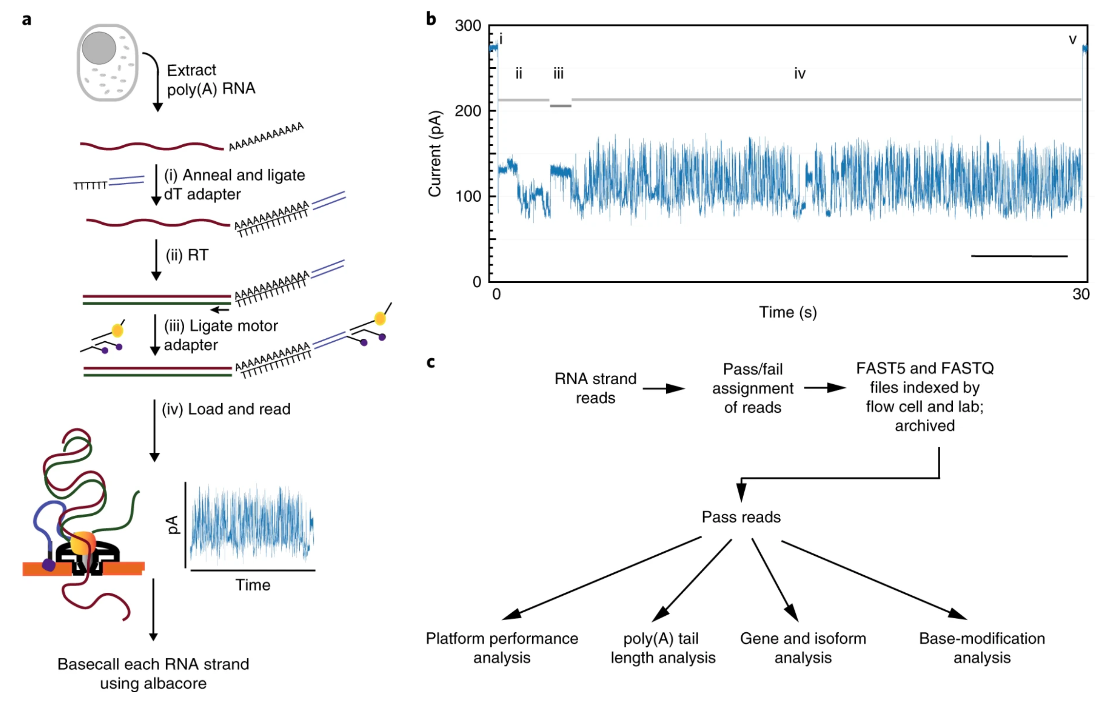
Now technically possible with the nanopore
Workman et al. Nature Methods 2019

Slide 4
Sequencing is not the only way to determine RNA abundances
From Otogenetics

Slide 5
Outline
STAR and SLURM
RseQC
RSEM and Salmon
Batch effect

Slide 6
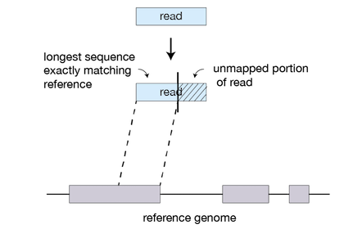
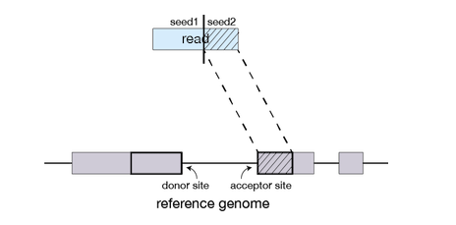
STAR (Spliced Transcripts Alignment to a Reference)
In RNA-seq, reads come from non-contiguous locations in the genome (due to splicing). An aligner must be aware of this.

Slide 7
STAR
Fast at the expense of being memory intensive (~30GB of RAM required for alignment human genome).
Therefore, the computation needs to be done on Pegasus.
STAR Reference manual: https://physiology.med.cornell.edu/faculty/skrabanek/lab/angsd/lecture_notes/STARmanual.pdf

Slide 8
Login to Pegasus
Simple version: Pegasus is a lot of small computers (nodes) combined to be one giant computer.
Login nodes are for logging on to the cluster and browsing files. No intensive computations should (can) be run on login nodes.
Compute nodes are for doing intensive computations (like STAR).

Slide 9
SLURM
How do I get from the login node to a compute node?
You need to specify what you need (RAM, CPUs). Other users are also asking for resources.
SLURM (Simple Linux Utility for Resource Management) manages user requests on Cannon.

Slide 10
SLURM
For STAR, I might want to ask for 64GB of RAM and 16 CPUs for 2 hours
srun --nodes=1 --ntasks-per-node=1 --mem=64G --cpus-per-task=8 --time=02:00:00 --pty bash -i

Slide 11
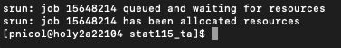
SLURM
For STAR, I might want to ask for 64GB of RAM and 16 CPUs for 2 hours
srun --nodes=1 --ntasks-per-node=1 --mem=64G --cpus-per-task=8 --time=02:00:00 --pty bash -i

Slide 12
SLURM
The more resources you ask for, the longer it takes. Try to run the following small job now:
srun --nodes=1 --ntasks-per-node=1 --mem=8G --cpus-per-task=1 --time=00:10:00 --pty bash -i
Type exit to go back to the login node.

Slide 13
Part 1: RNA-seq QC + Pegasus work

Slide 14
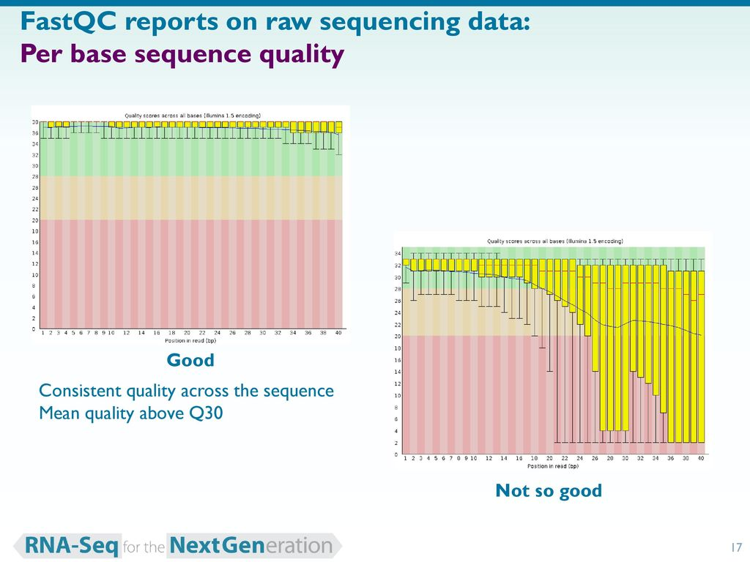
FastQC
Super fast + easy to use!
> fastqc <fastq_file>
From Bethany Hill

Slide 15
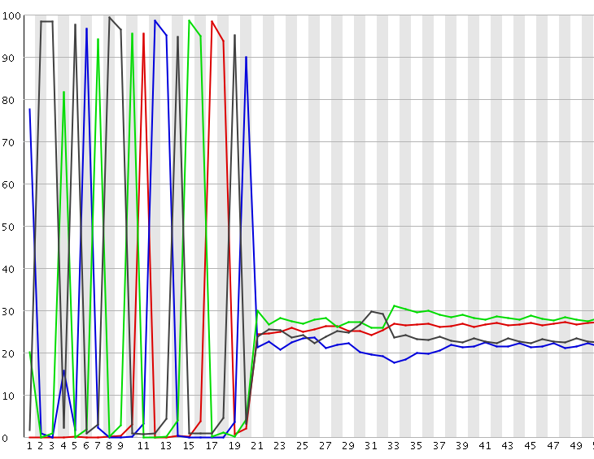
FastQC
% nucleotide frequency
Position in read

Slide 16
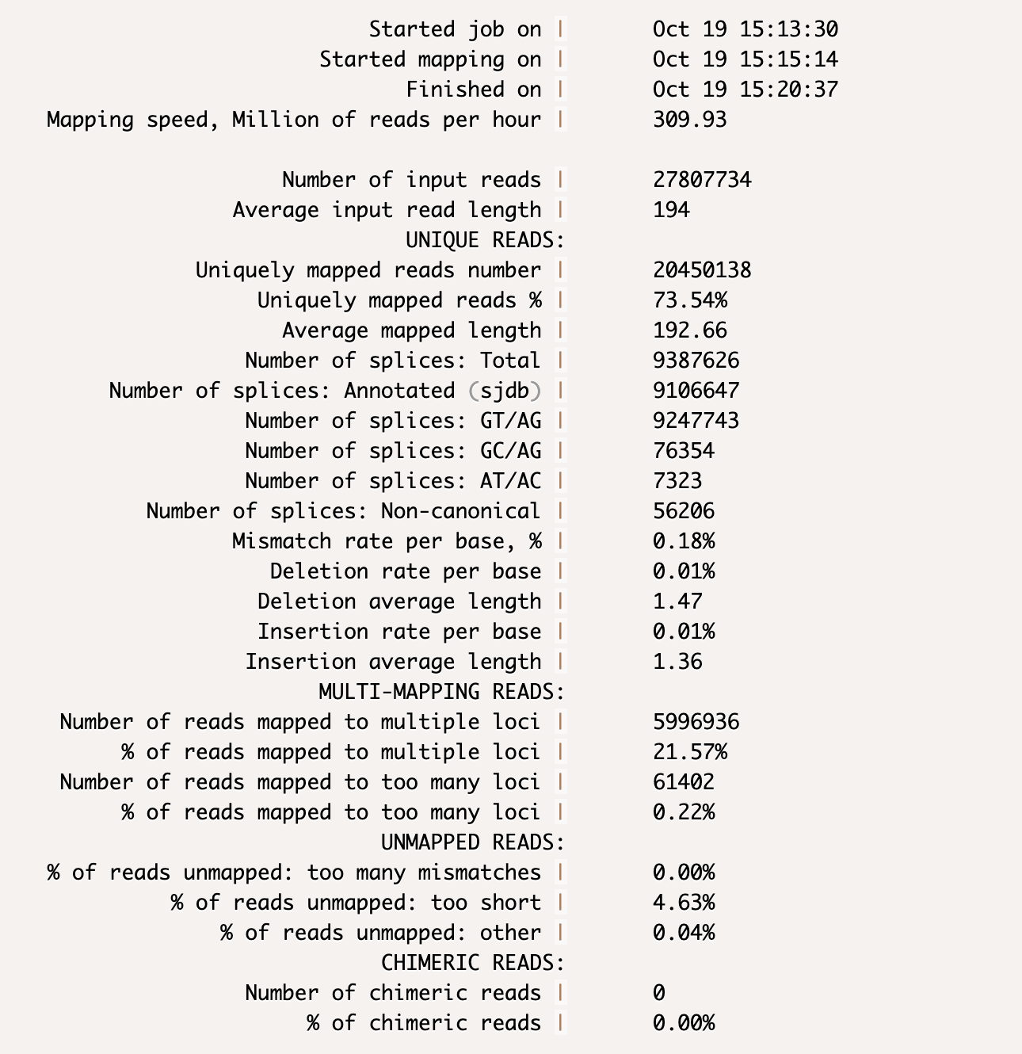
STAR QC (via alignment)

Slide 17
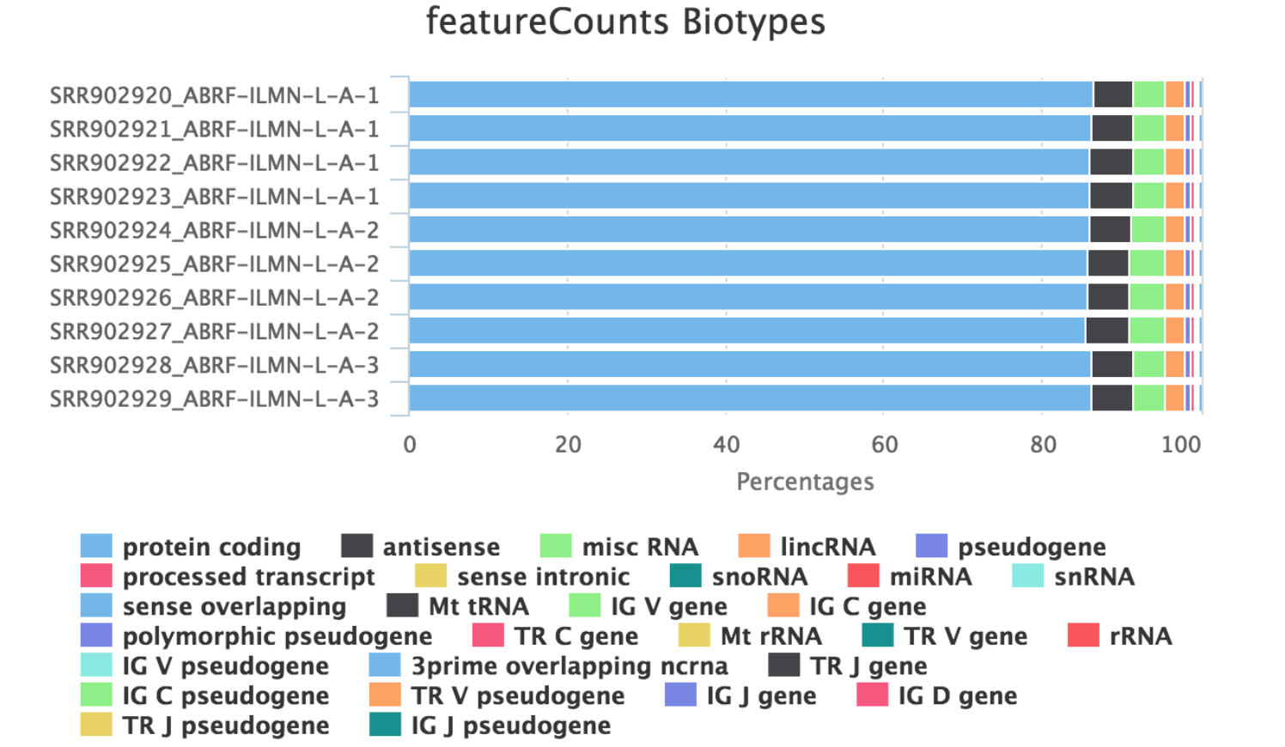
More RNA-seq QC
https://github.com/nf-core/rnaseq/blob/master/docs/output.md

Slide 18
Pegasus work – what if you don’t have modules
> module load Anaconda/5.0.1-fasrc02
> conda create -n <env_name> python=2.7
> source activate <env_name>
> conda install -c bioconda rseqc
Run line #2 only once to set up environment
Run line #3 to reuse the environment (e.g. you go home and log back on)
N.B. we are only using Python 2 because the recipe exists for rseqc

Slide 19
Python 3 conda environment (not required for this lab)
> module load Anaconda3/5.0.1-fasrc02
> conda create -n python3env python=3.8
Can toggle environments:
> source activate python3env
> source activate python2env

Slide 20
Execute tin.py from RSeQC for a quick test
> bed=/n/stat115/2020/HW2/lab3/small_hg38_RefSeq.bed
> cp /n/stat115/2020/HW2/lab3/test_* .
> bam=test_small_bam.bam
> python ~/.conda/envs/<env_name>/bin/tin.py -i $bam -r $bed
> head *summary.txt
NOTE: Do not use this bed for the homework! It is a subset of transcripts to use for faster processing. The real .bed file has ~150,000 lines. Takes ~2hr to run.

Slide 21
Part 2 - Pseudoalignment
Two main tools:
- Salmon (used in this problem set)
For HW: salmon quant -r
- Kallisto (generally the same)
Nice to use if restricted to a laptop
STAR is very fast too but requires a lot of RAM
Limitations…?

Slide 22
STAR Guide – 1. Start the job and load module
Start an interactive job with sufficient resources. Batch jobs are also possible but harder to troubleshoot.
Go to your home directory if you are not already there by typing cd ${HOME}
Load STAR with module load STAR/2.6.0c-fasrc01
The basic command is STAR followed by a list of options.

Slide 23
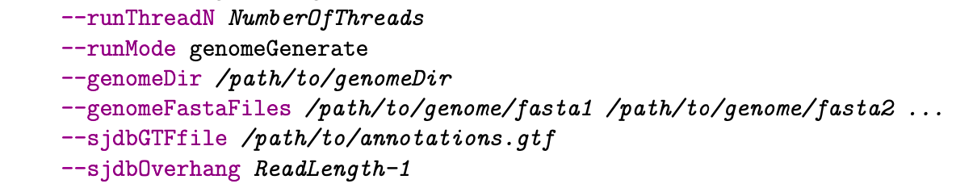
STAR Guide – 2. Make the index (NOT REQUIRED FOR HW)
We have already done this for you and have saved the output to /CHILDRENS/groups/ligrp/GENO8232/HW/HW1/reference
If you want to try it yourself (in your home folder), the raw human genome sequence files are in /CHILDRENS/groups/ligrp/GENO8232/HW/HW1/reference/GRCh38.fa

Slide 24
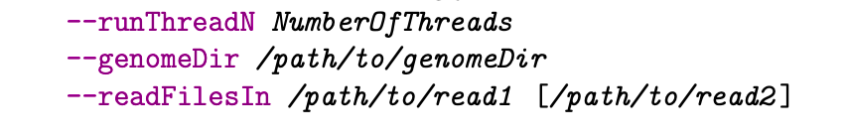
STAR Guide – 3. Perform alignment
STAR –-genomeDir <INDEX PATH> --readFilesIn <FASTQ FILES> --runThreadN 8
Run time is around 15 minutes.

Slide 25
STAR Guide – 4. View the results
STAR will create some output files that will be useful for answering problem 1 on the homework. What is the fastest way to view the contents of a file?

Slide 26
STAR Guide – 4. View the results
STAR will create some output files that will be useful for answering problem 1 on the homework. What is the fastest way to view the contents of a file?
cat <filename>
Or Less <filename>

Slide 27
STAR Guide – 4. View the results
STAR will create some output files that will be useful for answering homework. What is the fastest way to view the contents of a file?
cat <filename>

Slide 28
Common mistakes on homework
Not specifying adequate time for the job (default is 5 minutes, you will want to specify at least 30 minutes, probably more).
Choosing runThreadN to be larger than --cpus-per-task (I normally choose threads to be half of the number of cpus I’ve requested).
Saving the output to /CHILDRENS/groups/ligrp/GENO8232 (Not writable to students).

Slide 29
RSeQC
mRNA is an unstable molecule. It is important to check if your sample has been degraded before performing further analysis.
RSeQC is a Python package (collection of scripts) that provides some measures of sample/transcript quality:
tin.py computes the Transcript Integrity Number (TIN), which is a measure of quality for each transcript. MedTIN takes the median transcripts across samples.
geneBody_coverage.py makes a gene body coverage plot.

Slide 30
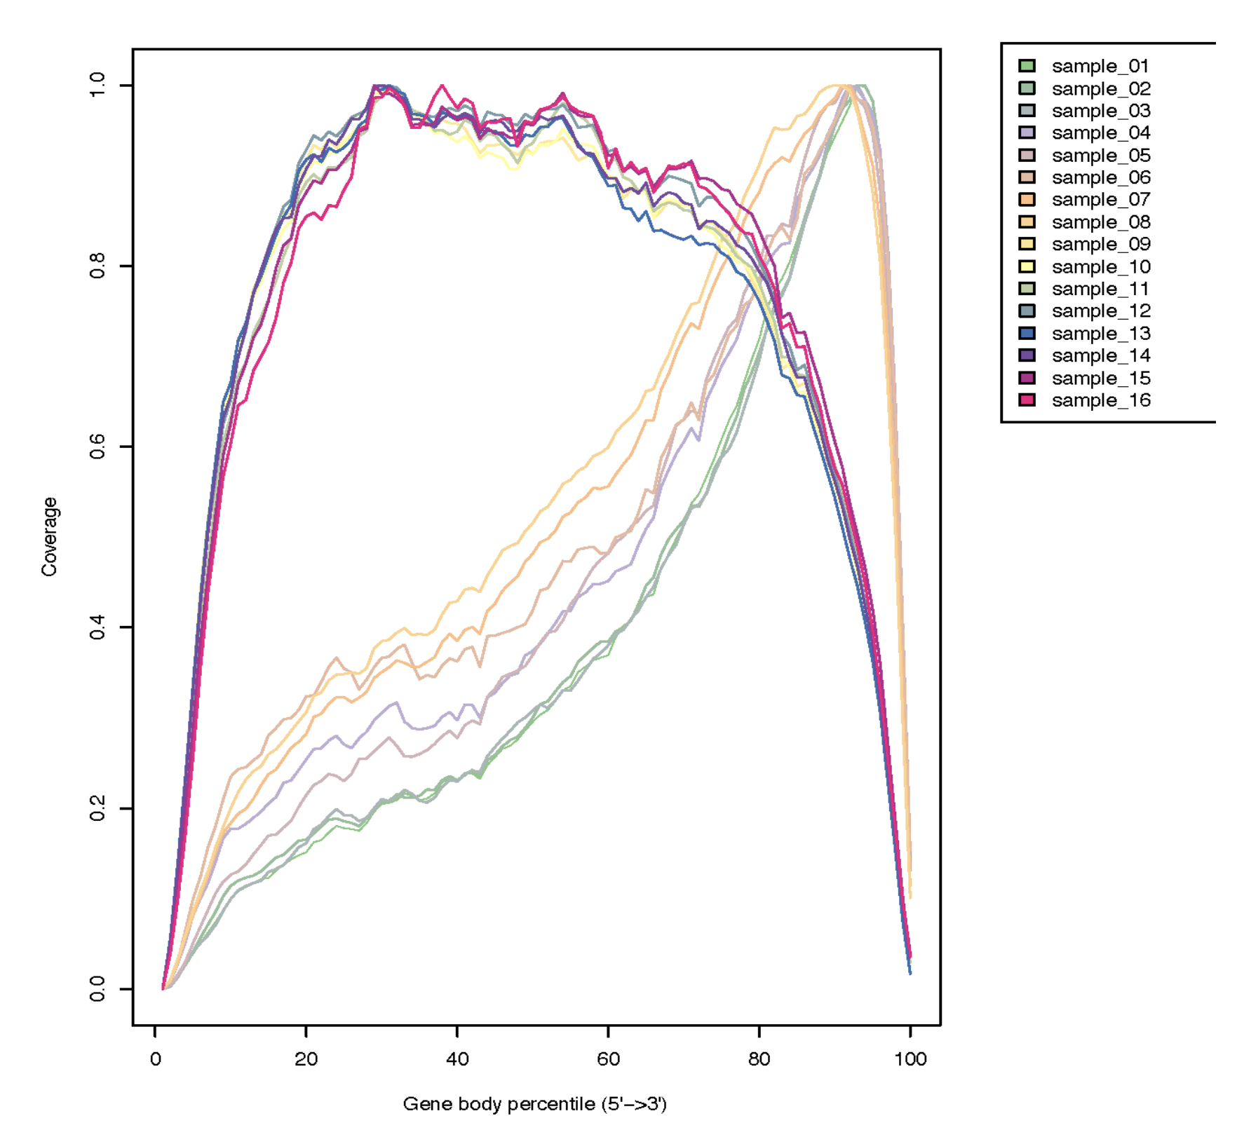
Gene Body Coverage
According to this plot, which samples may have been degraded and why?

Slide 31
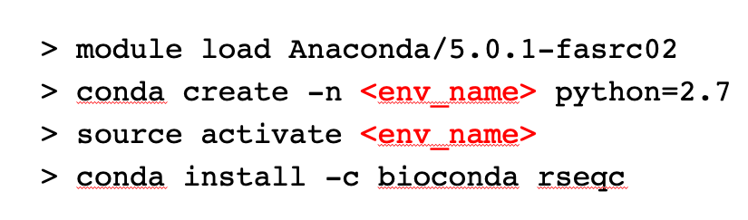
How to install RseQC
The relevant python files are then contained in ${HOME}/.conda/envs/<env_name>/bin

Slide 32
How to run RseQC
As usual, go to a compute node. Then module load Anaconda/5.0.1-fasrc02 and source activate <env_name>

Slide 33
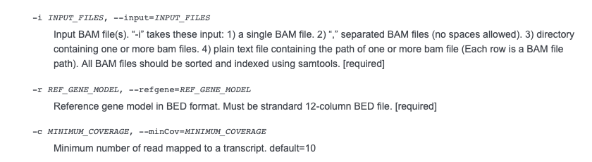
Running tin.py
Housekeeping genes are stored in the raw_data2 folder, please use these for reference genes. Runtime is approximately 30 minutes.

Slide 34
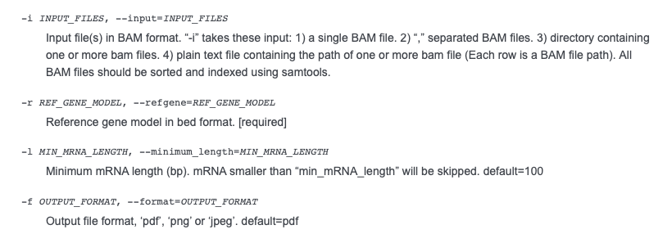
Running genebody_Coverage.py
Also run module load R before calling this script, since it will automatically make plots for you.

Slide 35
Transferring files from Pegasus to your computer
You may want to transfer the files to your local computer so that you can make plots easier.
(This probably only works for Mac OS/Linux users): from the terminal of my computer, I can type
scp we_li@pegasus.colonialone.gwu.edu:<PATH TO FILE ON PEGASUS> <DESTINATION_PATH>

Slide 36
Tips for Problem 3 (Python)
The values in the text file output by geneBody_coverage.py are not standardized to be between 0 and 1. You should divide by the maximum coverage in each sample.
Creating subplots in Python: https://matplotlib.org/3.1.0/gallery/subplots_axes_and_figures/subplots_demo.html

Slide 37
Salmon and RSEM
Salmon and RSEM are algorithms for RNA-seq quantification.
What are two confounders of read count?

Slide 38
Salmon and RSEM
Salmon and RSEM are algorithms for RNA-seq quantification.
What are two confounders of read counts?
Counts are influenced by gene length and the number of reads per sample.
Normalization methods such as CPM (Counts per million), RPKM (Reads per kilobase million), FPKM (Fragments per kilobase million), TPM (Transcripts per million) are commonly used for accurate quantification of gene expression.
RNA-seq blog (from lecture): https://rna-seqblog.com/rpkm-fpkm-and-tpm-clearly-explained/

Slide 39
Running Salmon
We can use the .fastq file as input.
Start a job.
module load salmon
The main command is salmon quant
-i Path to index (in Stat 115 index folder)
-r Path to Input reads (as FastQ)
-p Number of threads
-l A Automatically detect if input data is paired-end or single-end
-o Name of output directory (your choice)

Slide 40
Salmon output
The file quant.sf contains the expression levels (TPM, effective length, read counts).
The file quant.sf is large, type head –10 quant.sf to see the first 10 lines

Slide 41
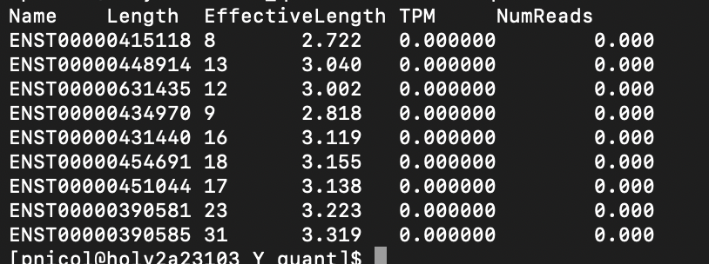
Salmon output
Part of the problem asks you to identify the gene with the highest expression. However, the output here is in ENSEMBL Transcript ID

Slide 42
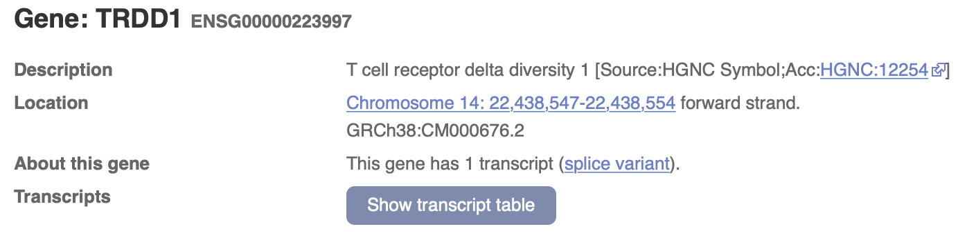
Use BioMart to get gene symbol from Transcript ID
BioMart: https://m.ensembl.org/biomart
For example, the first transcript ID on the last slide is ENST00000415118.

Slide 43
Running RSEM
For RSEM, you should first run STAR on the fastQ file to get a BAM file containing the alignment.
STAR *Other parameters* --quantMode transcriptomeSAM --outSAMtype BAM SortedByCoordinate
This creates a file Aligned.toTranscriptome.out.bam that can be used as input to RSEM.

Slide 44
Running RSEM
The main command for RSEM (load the module first) is rsem-calculate-expression
--no-bam-output
--time Output a .time file giving the runtime (useful for Problem 5).
--bam Input is a bam file
-p Number of threads
[input file] Name of input file
[reference_name] Reference (in Stat115 index folder)
[sample_name] Name of the sample (for output)

Slide 45
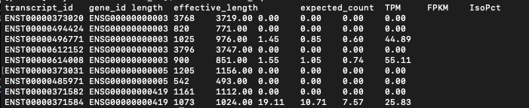
RSEM output
Output is in a file ending with .isoforms.results

Slide 46
Batch effects

Slide 47
What are they?
Providing a complete and unambiguous definition of the so-called batch effect is a challenging task, especially because its origins and the way it manifests in the data are not completely known or not recorded.
In molecular biology, a batch effect occurs when non-biological factors in an experiment cause changes in the data produced by the experiment. Such effects can lead to inaccurate conclusions when their causes are correlated with one or more outcomes of interest in an experiment.
Source: Wikipedia

Slide 48
Batch effects from various points of view
Biologist:
The experiments for group A were done on day 1 with reagents and machine X.
The experiments for group B were done on day 3 with reagents and machine Y.
We want to compare samples from groups A and B.
Statistician:
Suppose you want to observe the effect of X on Y but there exists a confounder Z. Z is associated with both X and Y.
Bioinformatician:
The data exists in a naïve state that, if uncorrected, will not allow be to understand the effect of the variable being measured (e.g. the drug treatment).

Slide 49
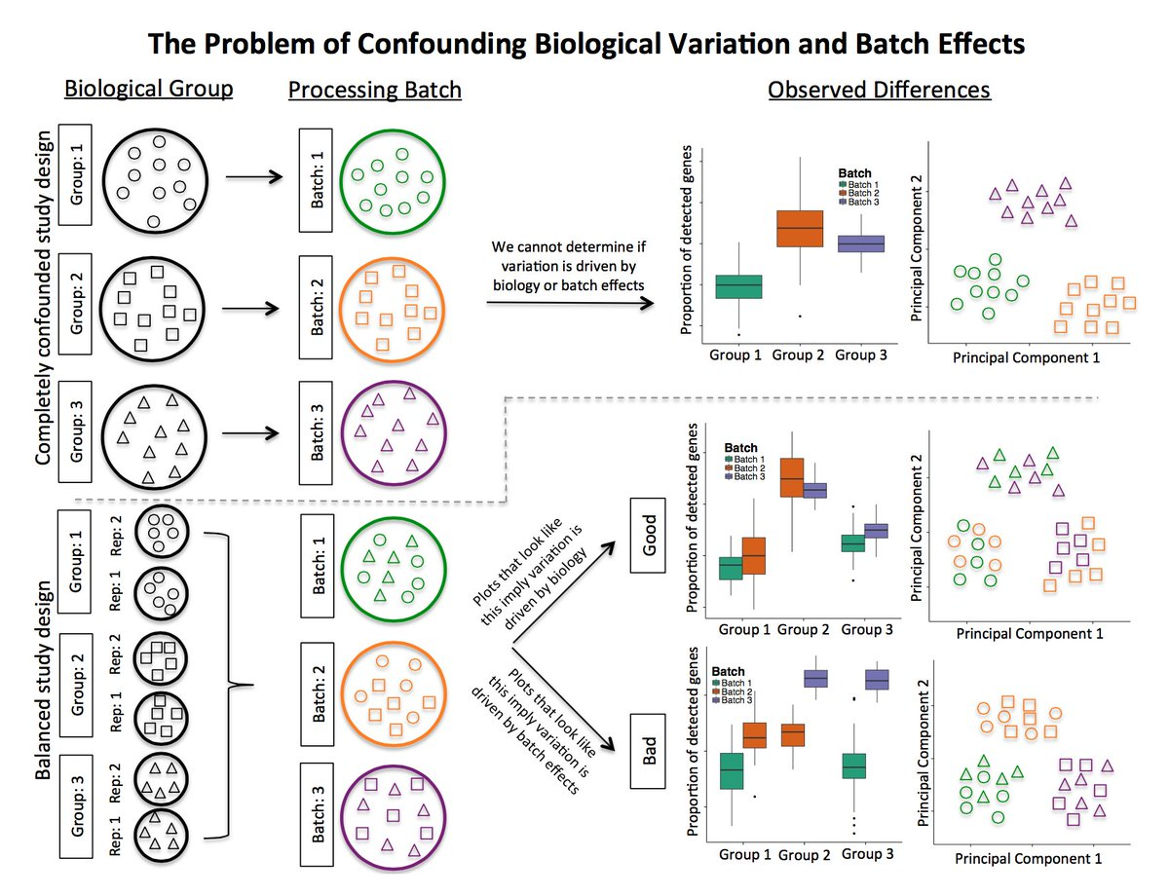
In a well-controlled experiment, batch effects are minimal
Hicks et al. 2017 Genome Biology

Slide 50
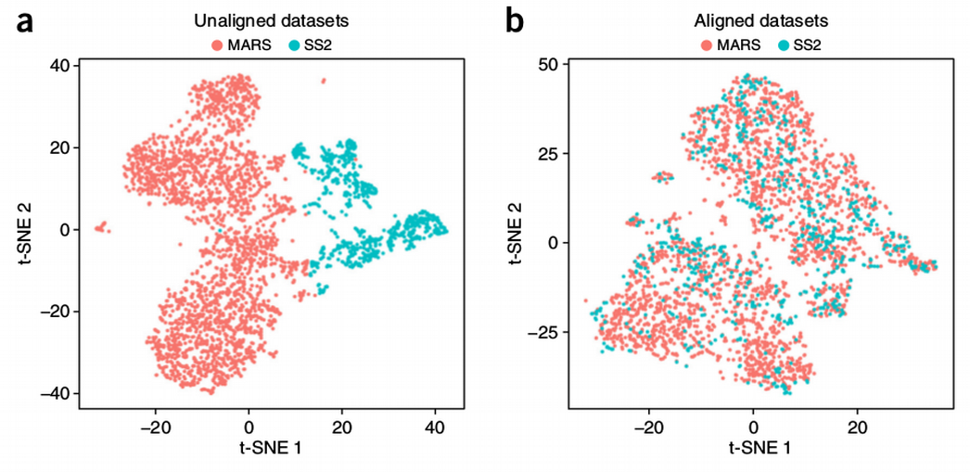
In single-cell data -> ‘alignment’
Butler et al. Nature Biotechnology 2018

Slide 51
Think about how batch effects in these contexts:
Scenario 1: only 3 or 4 genes are induced by a very specific perturbation (e.g. CRISPR activation of an enhancer). The control gRNA experiments are performed with a different cell culture.
Scenario 2: Peripheral blood from 100 patients with AML are drawn and processed. You later realize that you want to compare them to healthy individuals. You recruit 100 controls.
Scenario 3: You process blood from 4 AML patients with 4 controls. You repeat this every day for ~4 weeks until you get a sample size of 200.

Slide 52

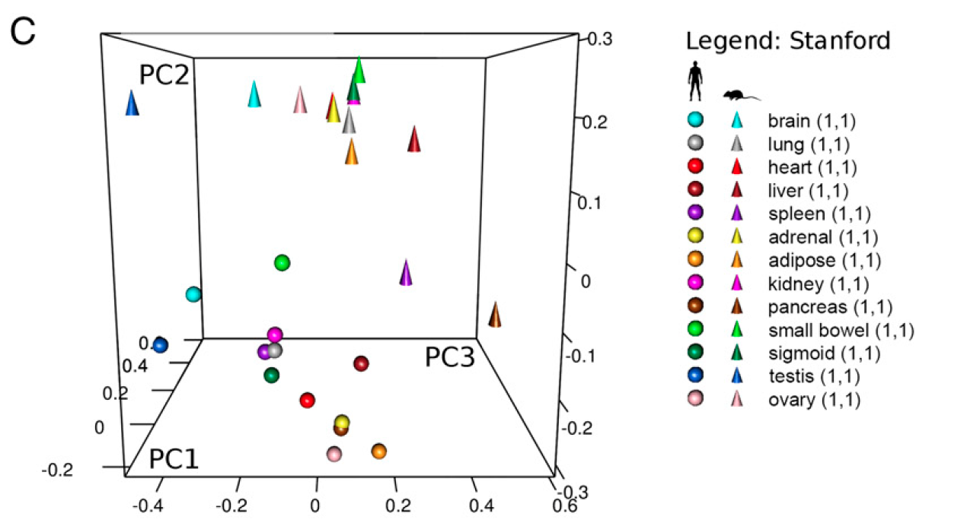
Part 3
Will walk through sample R code after break…

Slide 53
DAVID example
Use the “erythroid_genes.txt” list to check for gene set enrichment using the web-based tool.

Slide 54
Python programming (Part 5)
import matplotlib.pyplot as plt
Rough pseudocode:
Script imports a directory name
Identifies all files + their names
Pull coverage per position into a data vector / list
Plot value per position and add the original name

Slide 55
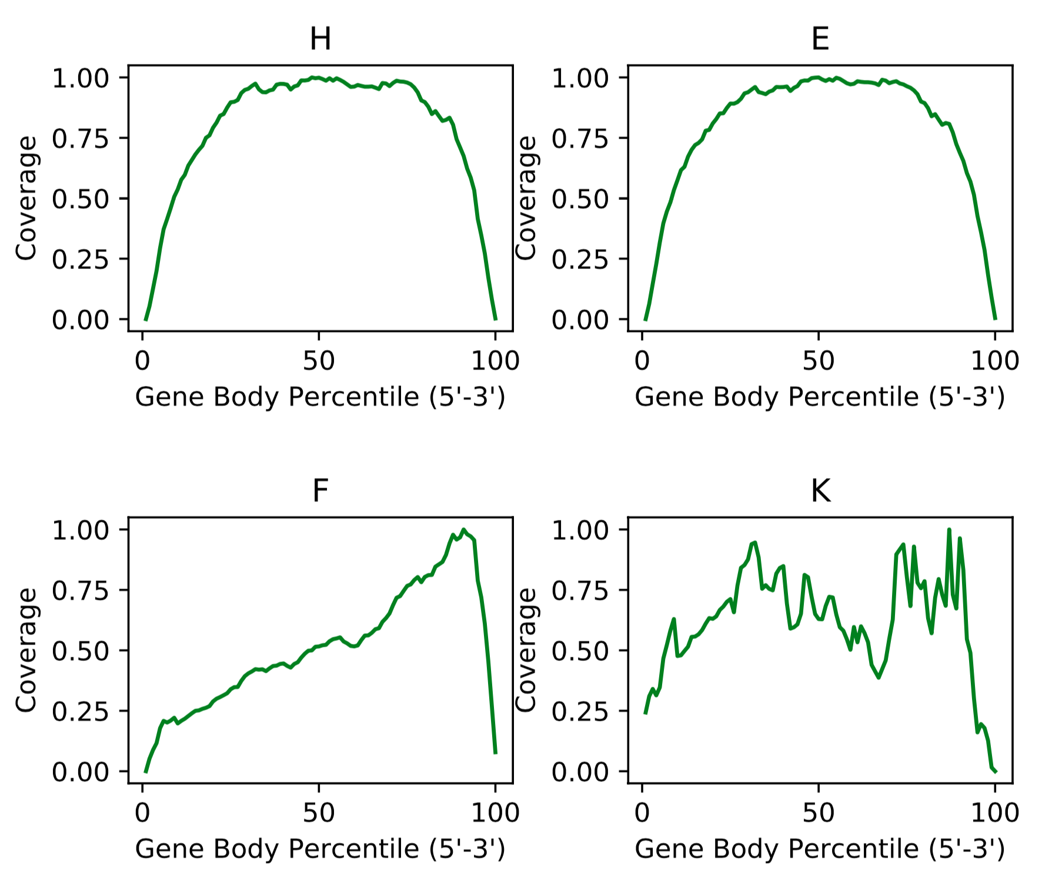
Example

Slide 56

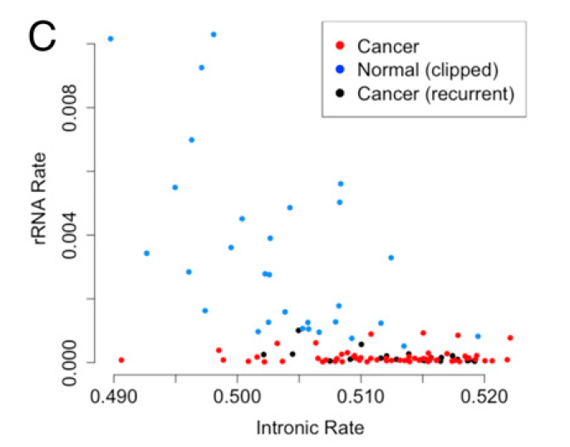
Part 6 – very recent batch example (2019/2020)

Slide 57
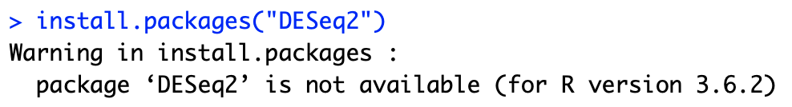
Common R error
1. Trying to install a Bioconductor package via CRAN
Fix:: use BiocManager::install
This error message is poorly communicated. When in doubt, google
‘install R package xyz’ (e.g. xyz = DESeq2) and you will see if it is on
CRAN or Bioconductor

